Slide 1
Entertainment
By: Front Row

Slide 2
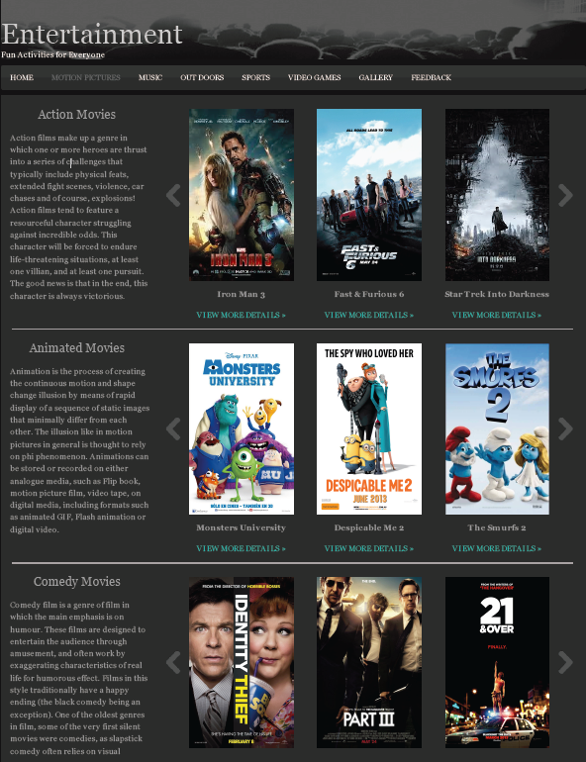

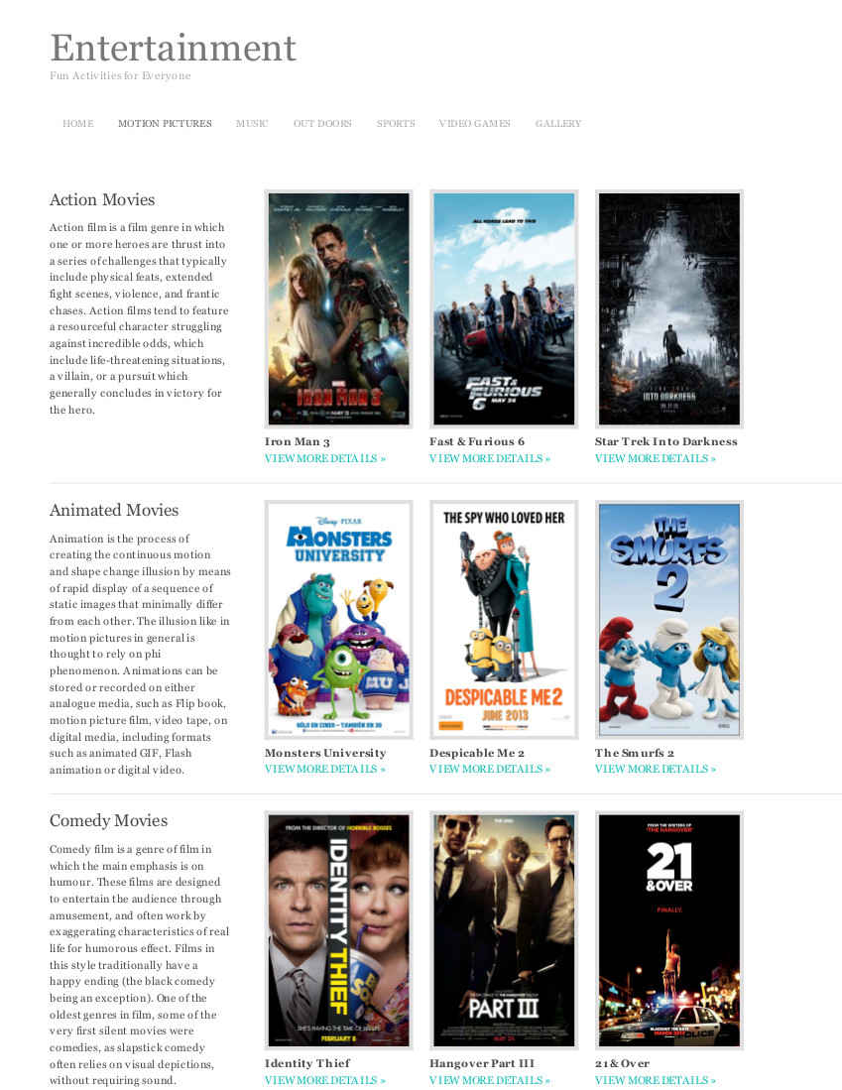
Motion Pictures
Action
Animated
Comedy
Horror
T.V. Shows

Slide 3

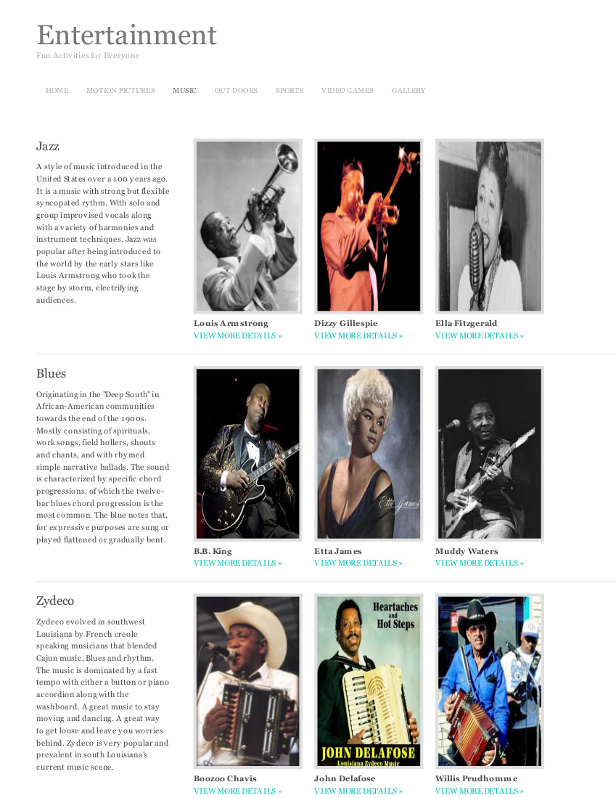
Music
Jazz
Blues
Zydeco
Swamp Pop
Live Music

Slide 4

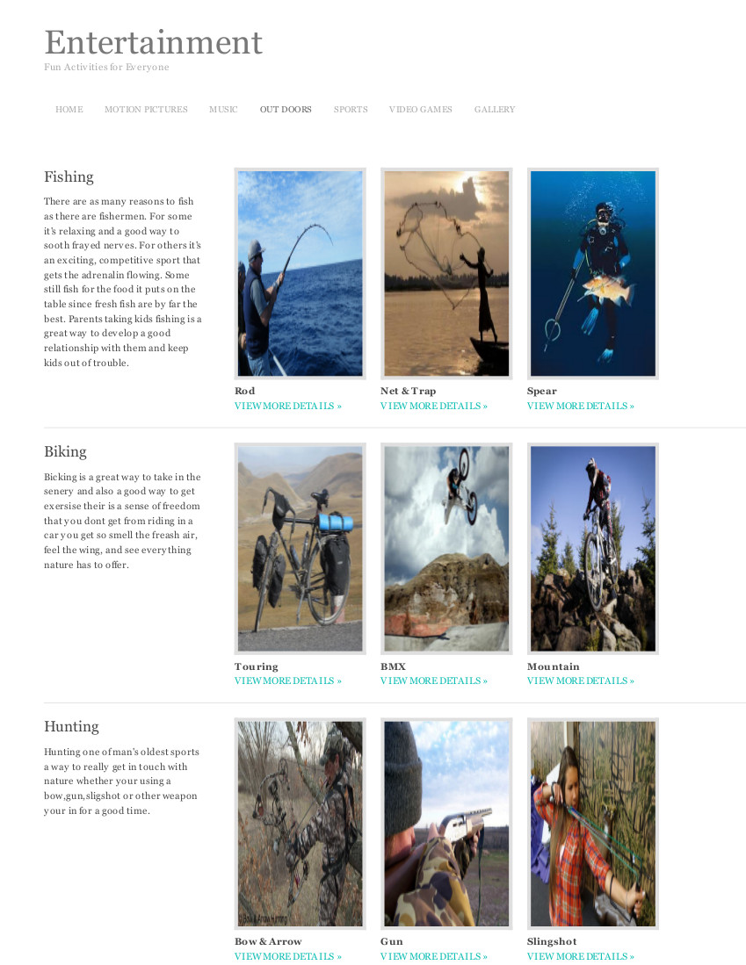
Outdoors
Fishing
Biking
Hunting
Water Sports
Snow Sports

Slide 5


Sports
Basketball
Baseball
Football
Soccer
Lacrosse

Slide 6
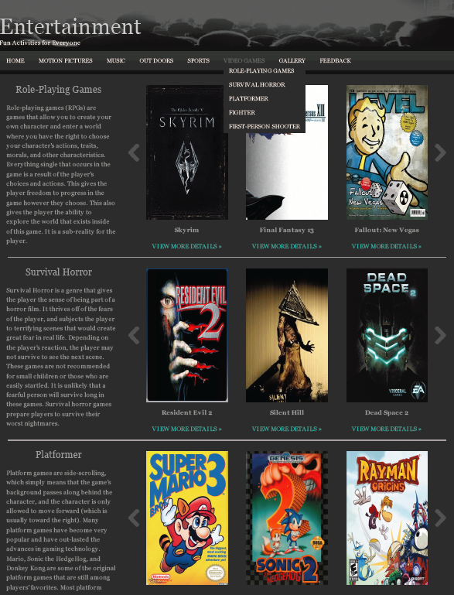
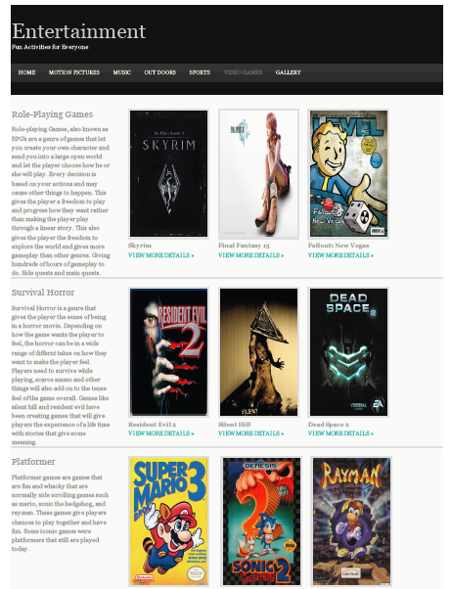
Video Games
Role-Playing Games
Survival Horror
Platform
Fighting
First-Person Shooter

Slide 7
Thank You All So Much
Scott Hansen
Ronald Rowe
Sonni Hearon
Brenda Sallier
Joseph Guy Holland

